Slide 1
Global Burden Of Diseases
1970 - 2010
By Jessica Thomas

Slide 2
Global Burden of diseases dataset
Multiple datasets where compiled and used in this exploratory and time series data analysis. The datasets had a varying number of variables, with some overlaps, like year and countries. Each datasets have rows such as estimated population and number of diseases, which are used to answer the question proposed. Each datasets have more than 10,000 entries, with some datasets containing 50,000 rows.
The datasets and its analysis can be found here.

Slide 3
Exploratory/Time series Data Analysis
Explore the changes in number of deaths and deaths rate per 100,000 in 1970, 1980, 1990, 2000, 2010.
Expectation: Advancement in medical technology has led to decrease in the number of deaths from 1970 - 2010?
Stats:
Pearson coefficient will be used to determine correlation between factors.
High statistics = value above 0.3 indicate a positive correlation is present.
Negative statistics = value above -0.3 indicate a negative correlation is present.

Slide 4
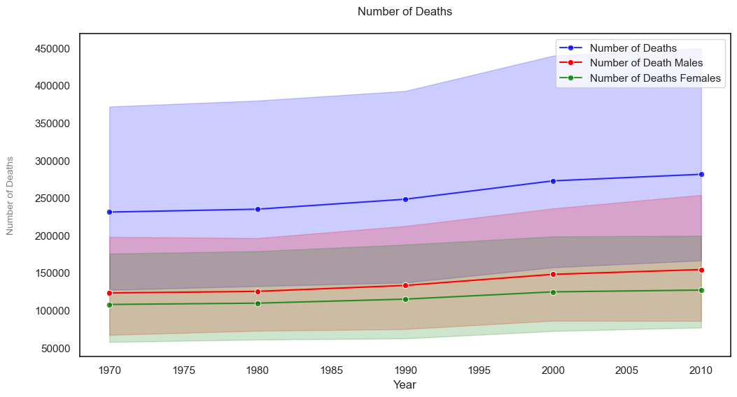
Did Number of Deaths decrease?
Based on the data used, number of deaths ahs increased overall from 1970 - 2010, regardless of gender.
14.614% more men died during these years compared to women.

Slide 5
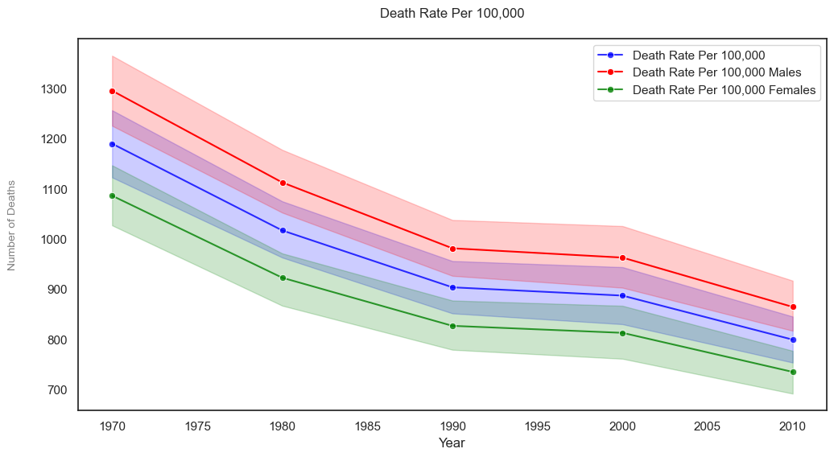
Did Death rate increase as well?
Counter to number of deaths, it seem that death rate per 100,000 has decrease over time.
Insights:
On average men have a higher death rate compared to women and both.
The fact that men have a higher death rate than both gender seem like an anomaly.

Slide 6
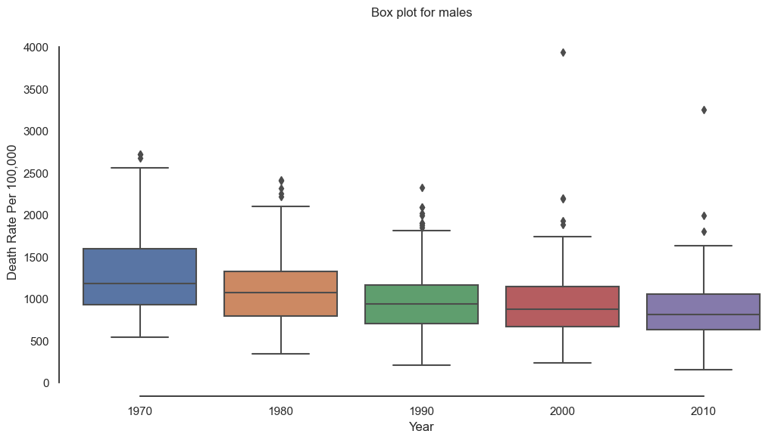
Death Rate: Male ?

Slide 7
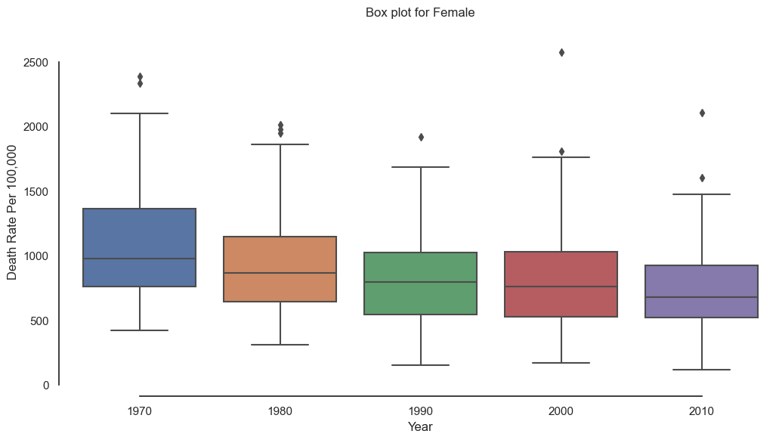
Death Rate: Female ?

Slide 8
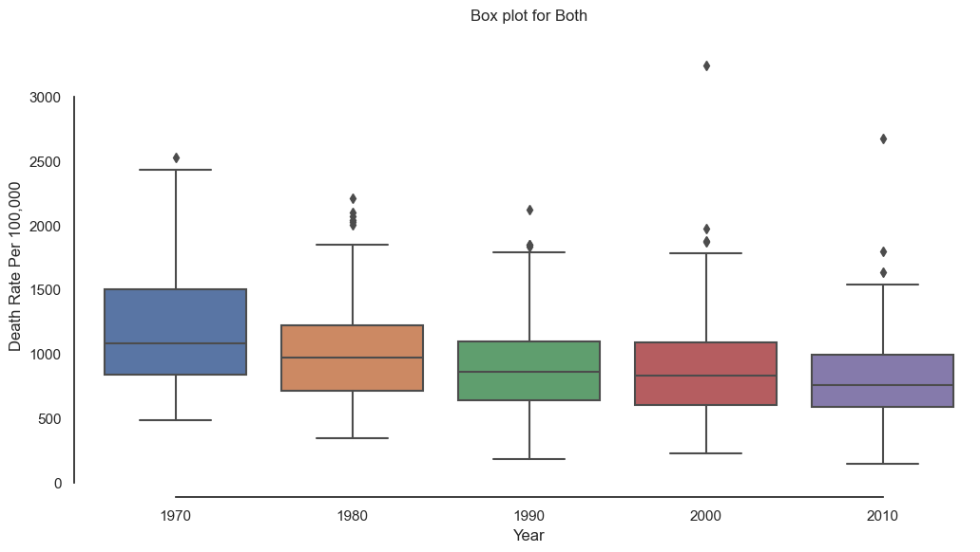
Death Rate: Both ?
Further analysis of the the death rate values show, the death rate for both men and women was calculated using the average of the men and women death rates.

Slide 9
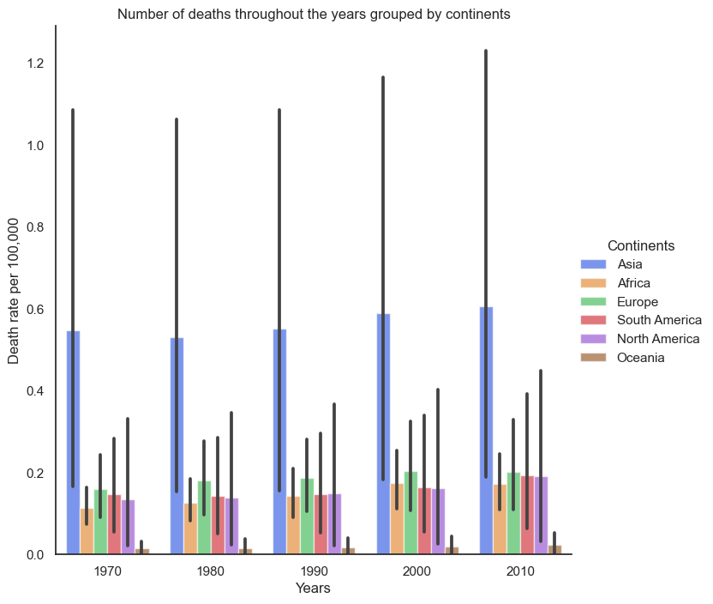
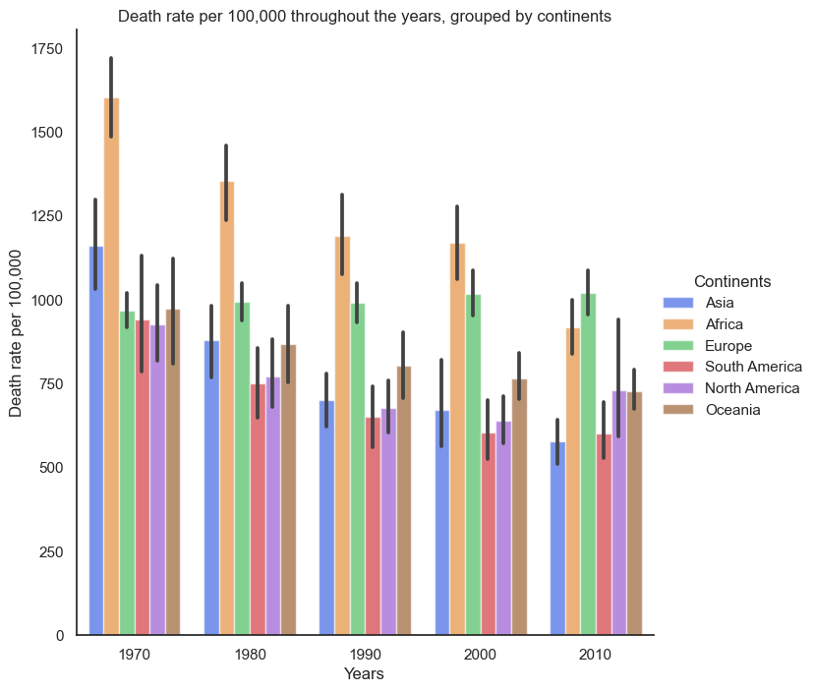
Number of Deaths and Death Rate per 100,000 grouped by continents.

Slide 10
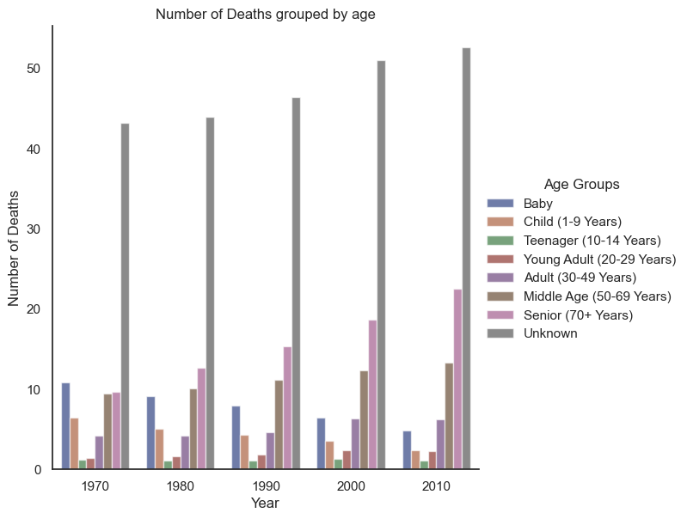
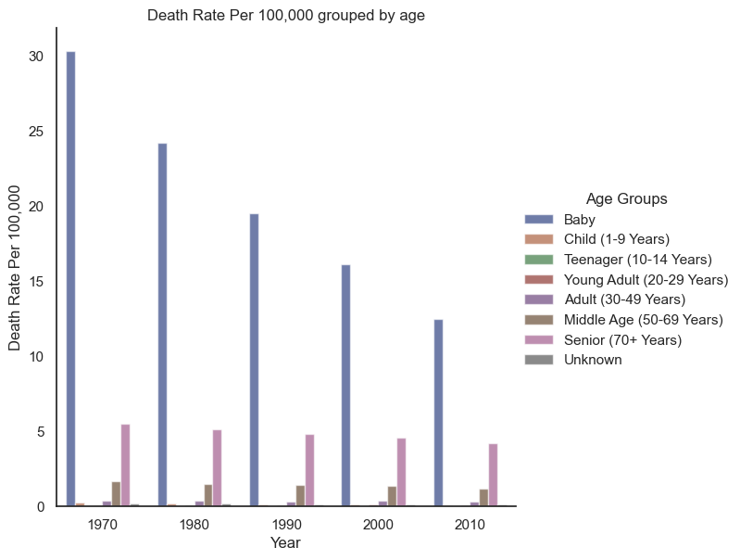
Number of Deaths and Death Rate per 100,000 grouped by age.

Slide 11
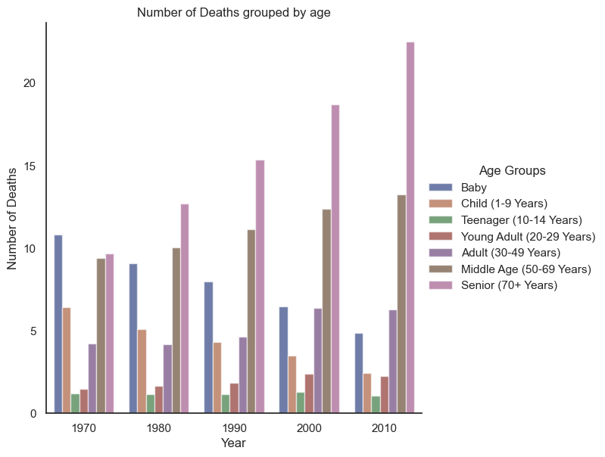
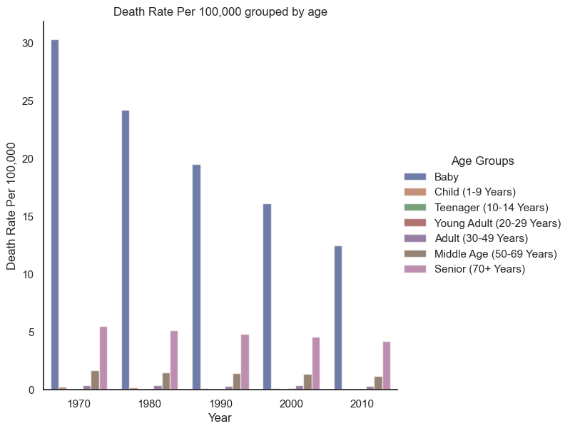
Number of Deaths and Death Rate per 100,000 grouped by age - no unknowns

Slide 12
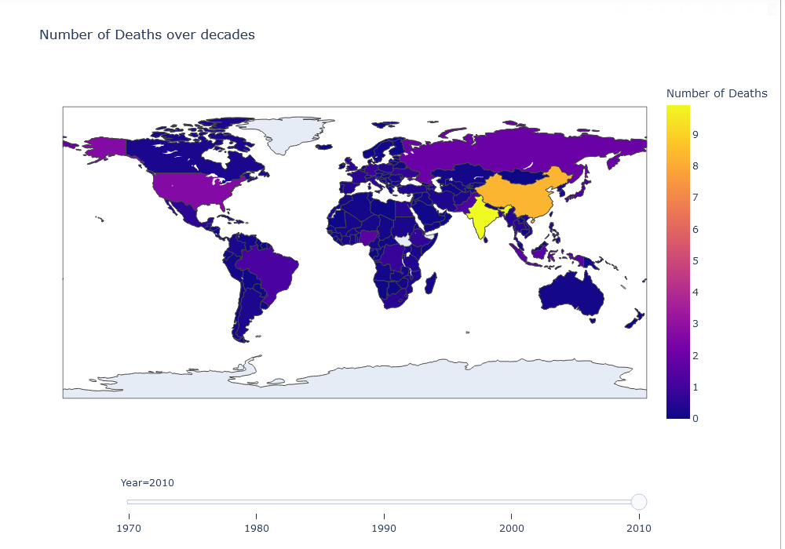
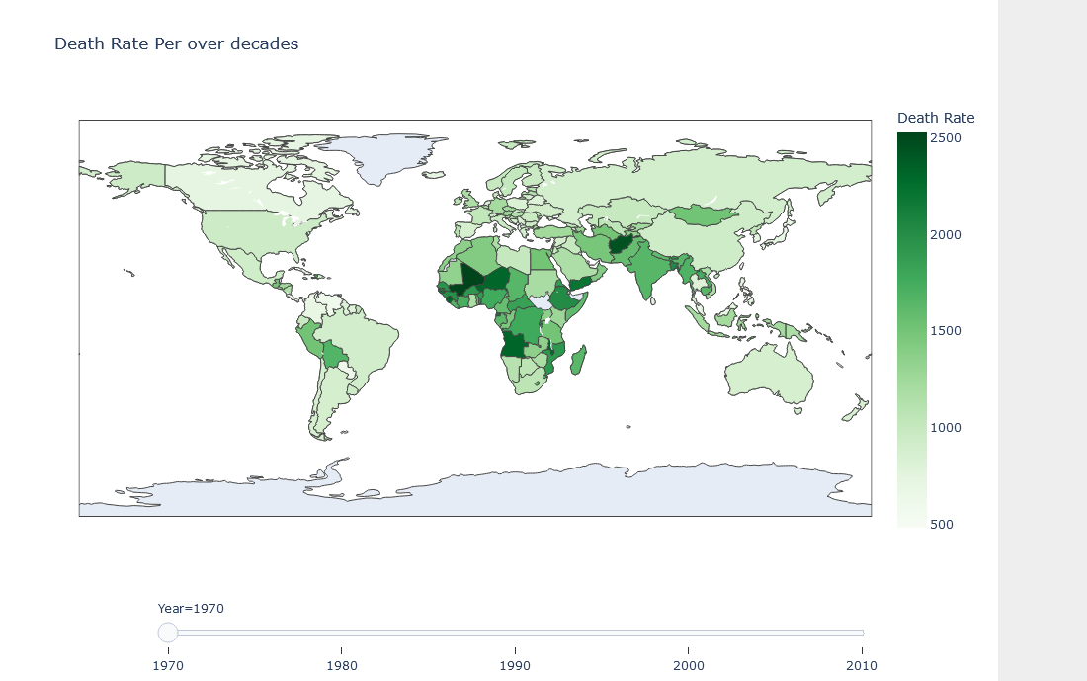
Are these changes seen when looking at the individual countries?
To explore this click here!

Slide 13
Why has the number of deaths increase?
To answer this question we will explore changes in:
Population
GDP per capita
Public health expenditure
Number of diseases

Slide 14
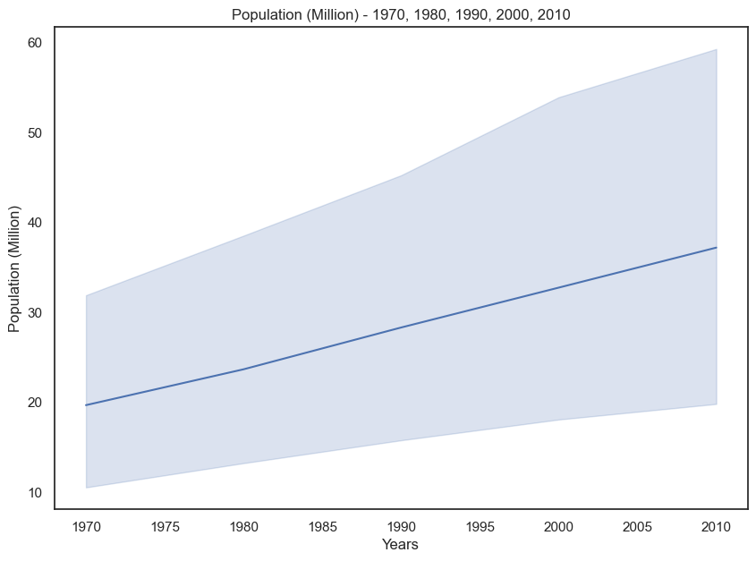
Population
Overall increase in population during these years.

Slide 15
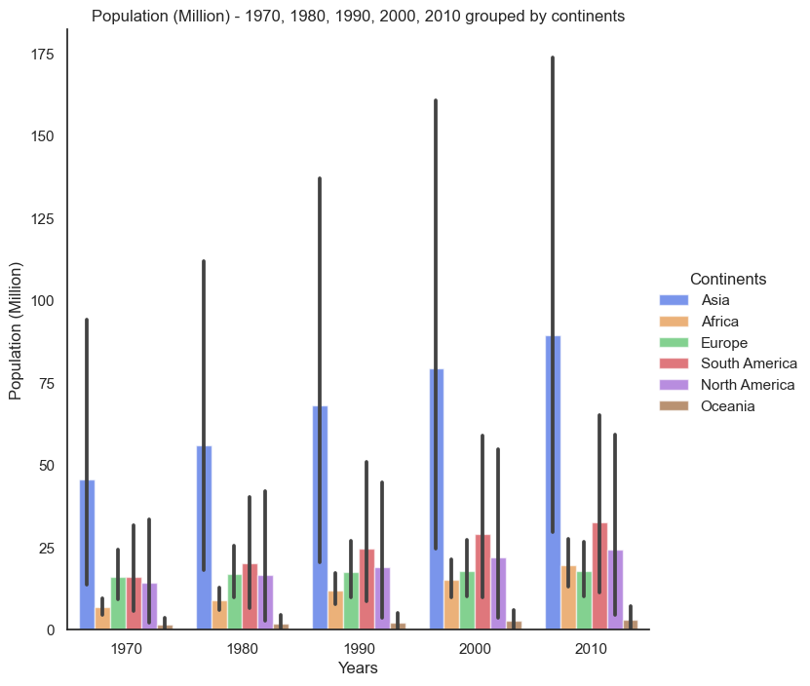
Population: Continents
Increase in population can be seen in a majority of the continents. Though the level of population increase varies.

Slide 16
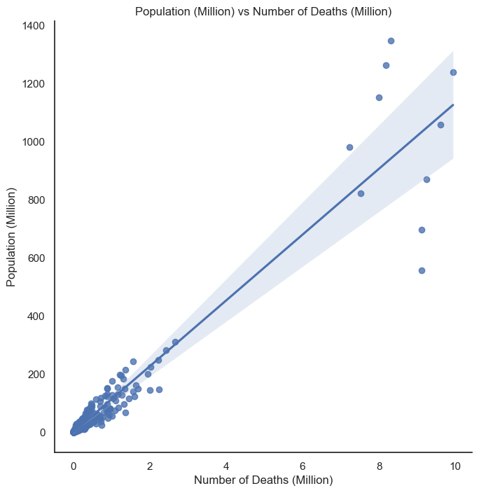
Population vs Number of Deaths
Statistic=0.9594703457015908
As expected there is a positive correlation between number of deaths and population. This is supported by the statistical calculation, which is close to 1.
This relationship will be further explored later.

Slide 17
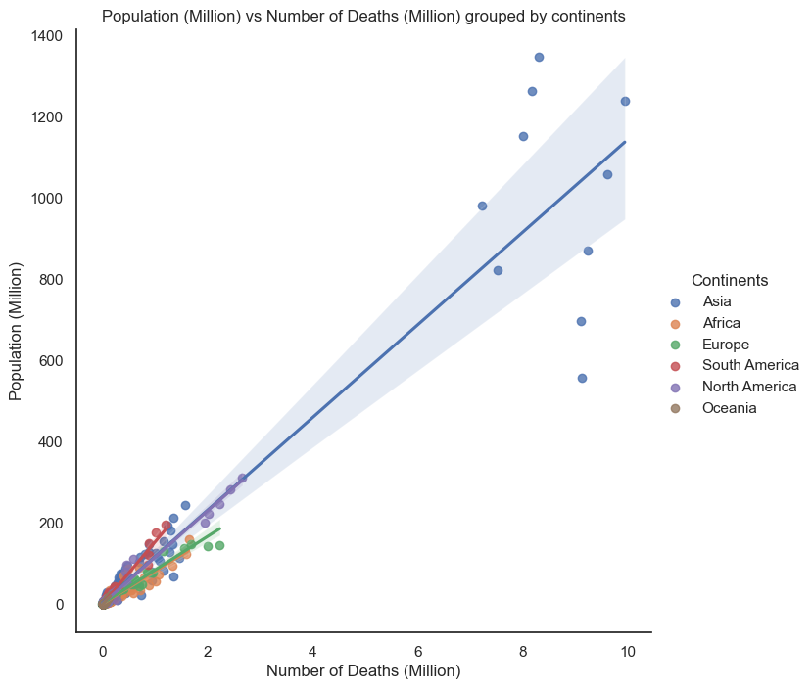
Population vs Number of Deaths: Continents
The positive correlation between population and number of deaths is maintained even when the values are grouped by continents.

Slide 18
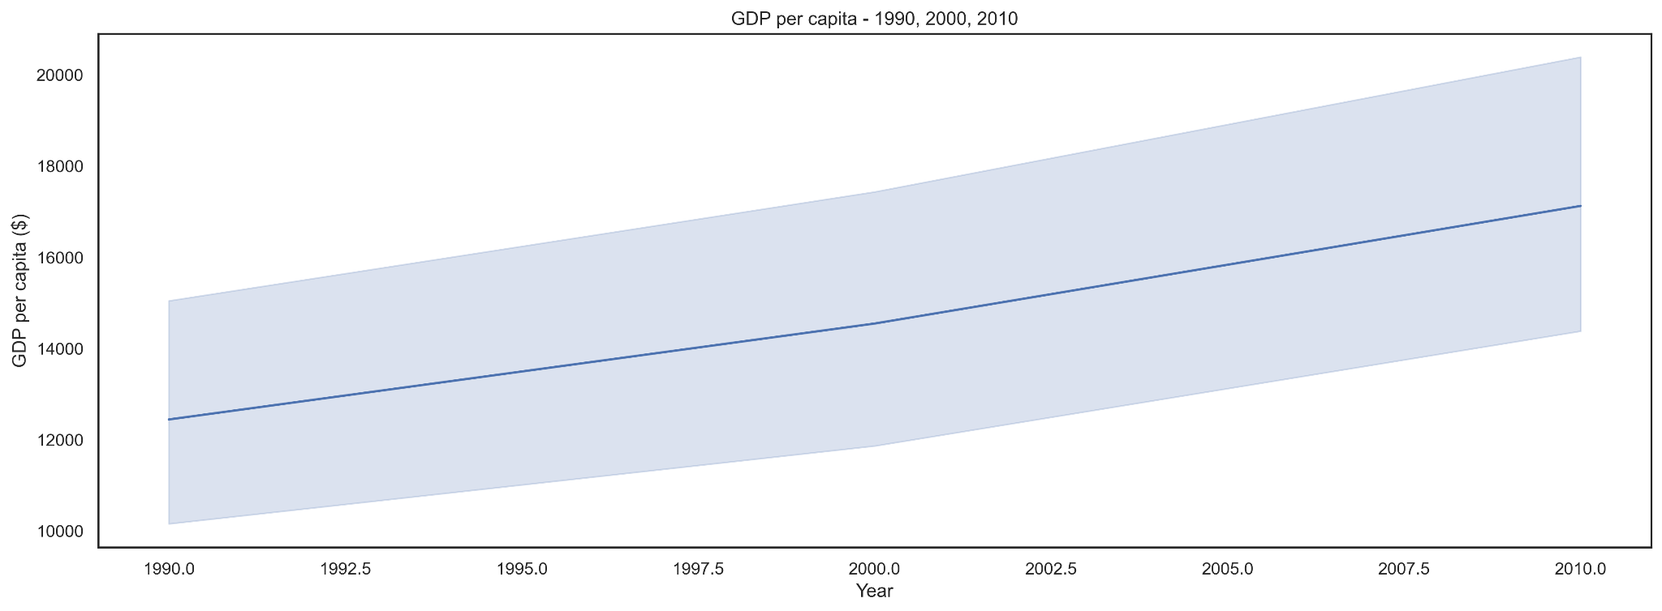
GDP Per Capita
As seen on the graph GDP per capita has increased overall from 1970 - 2010.

Slide 19
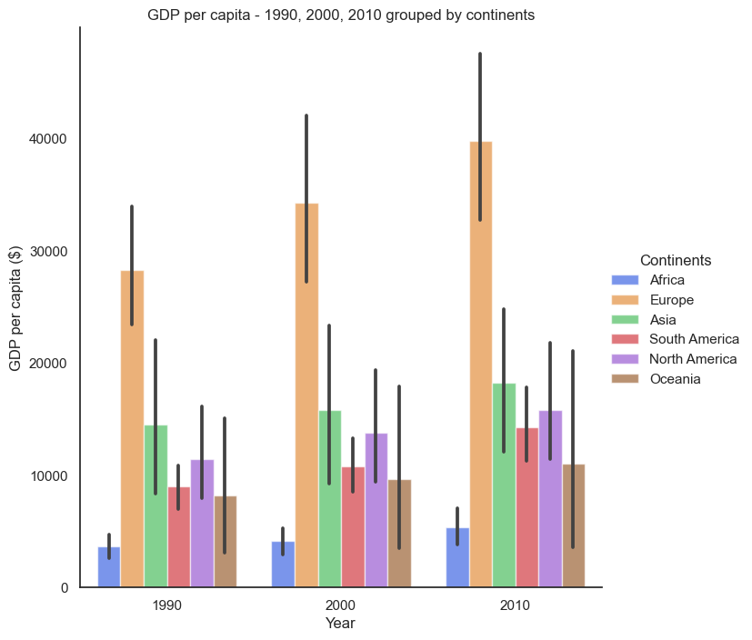
GDP Per Capita:
Continents
A closer look at GDP per capita, grouped by continents, further proves the previous statement. Irregardless of continents, GDP per capita has increased.

Slide 20
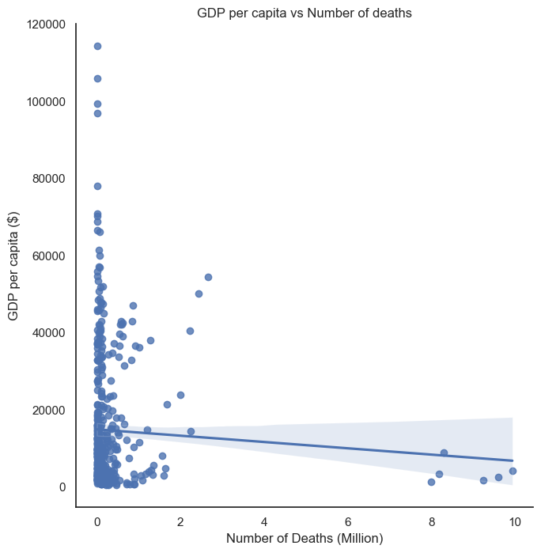
GDP per capita vs Number of deaths?
An analysis of these two factors show there is no correlation between GDP per capita and number deaths.
A decrease in GDP has little to no effect on the number of deaths.
This lack of a correlation is proven by statistical calculation:
Statistic : indicates that the correlation between these factors is not statistically significant, as -0.04 is less than -0.3.
Statistic=-0.04896476268010751

Slide 21
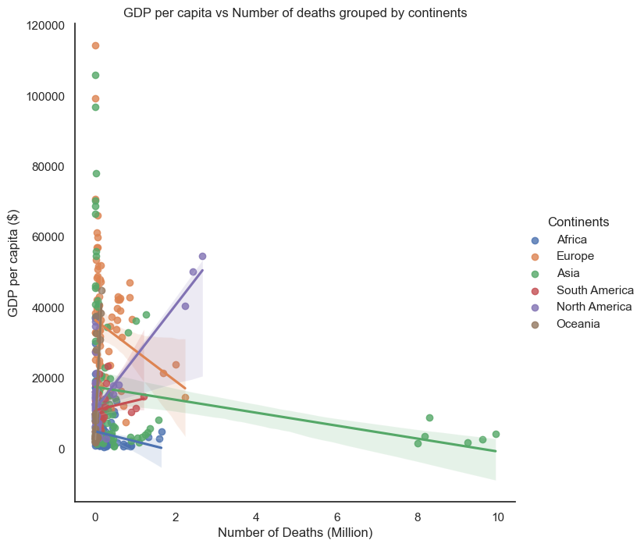
Is this relationship seen when the values are grouped by continents?
The correlation between GDP changes when the values are grouped by continent. Also the type of correlation produced, varies and the effect in which GDP has on number of death differs.
North America: an increase in GDP result in an increase in number of deaths.
Europe: a decrease in GDP result in a increase in number of deaths.

Slide 22
Potential reasons for this?
Distribution of wealth:
Varies based on continent and country
Unequal distribution of wealth
Access to health service:
Health services access varies based on continent and countries.

Slide 23
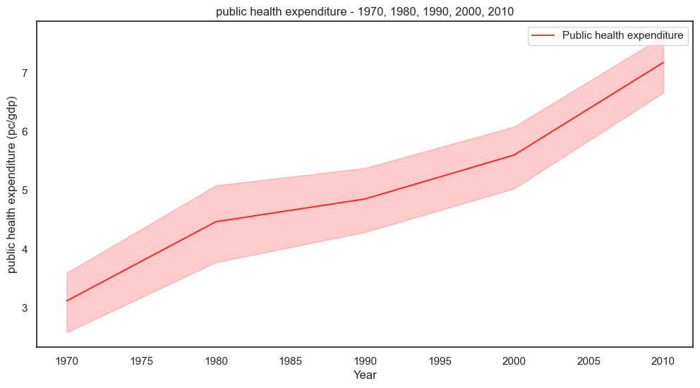
Public Health Expenditure
Public health expenditure has increased over the years in every continents.

Slide 24
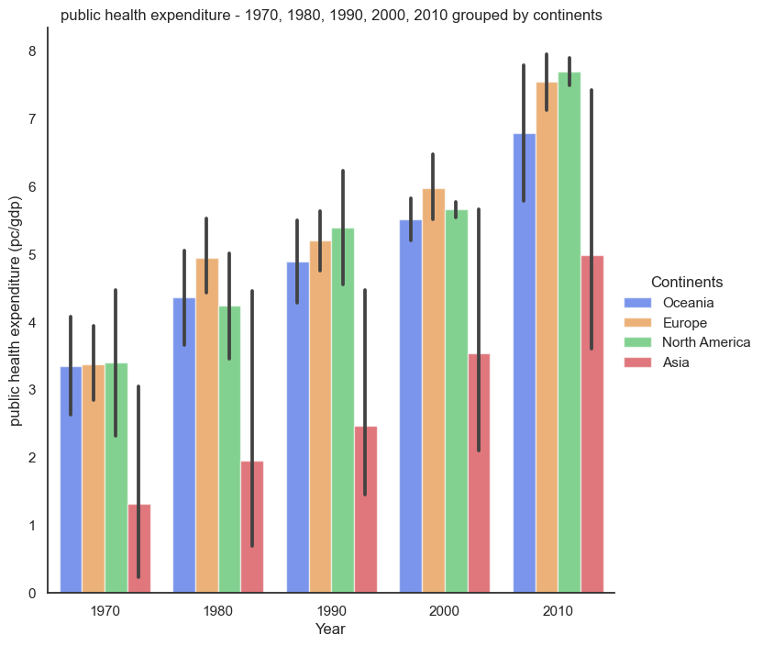
Public Health Expenditure: Continents
This increase in public health expenditure can be seen, when the values are grouped based on continents. Though, the level in which public health expenditure increases, differs.
Asia and North America experience the largest increase.

Slide 25
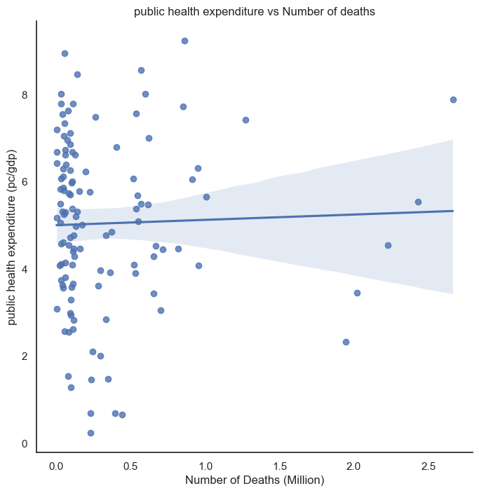
Public Health Expenditure vs Number Of Deaths
Statistical analysis of public health expenditure and number of death, provides evidence that there is no correlation between these two factors.
This indicated by the fact the statistic value is less than 0.3.
Statistic=0.030932625779898207

Slide 26
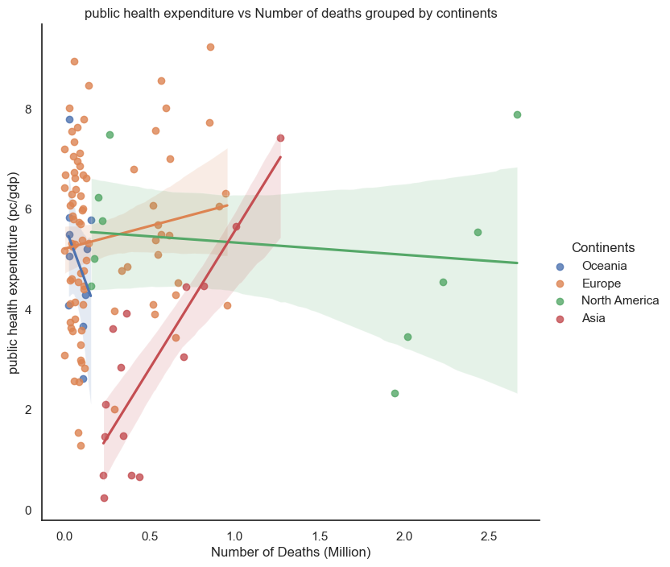
Public Health Expenditure vs Number Of Deaths: Continents
Further analysis of the relationship between these two factors, shows that there is a correlation. The correlation present is dependent on the continent.
For example, a positive correlation is present in Asia. This means, as public health expenditure increase, so does number of death.
The significance of these correlation is questionable and needs to be statistically calculated.

Slide 27
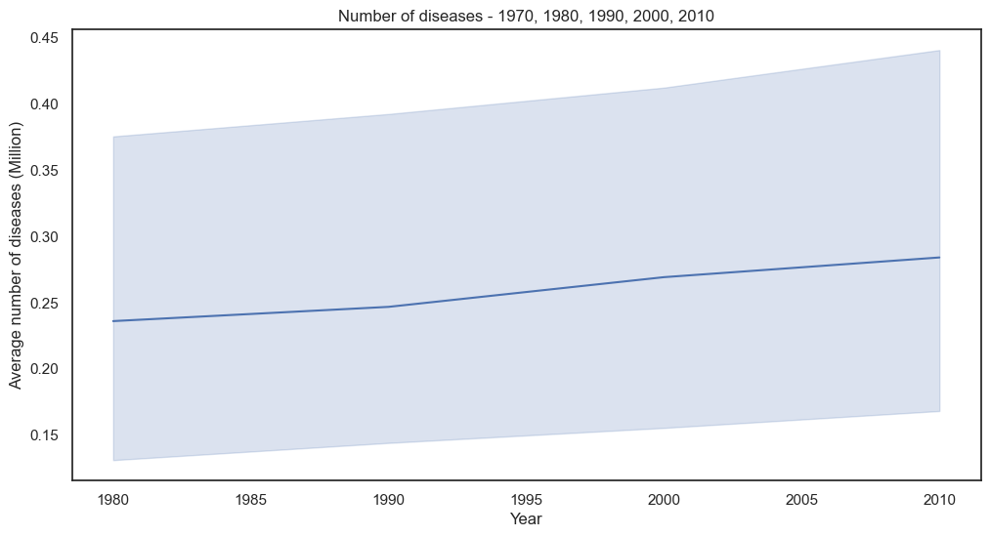
Number Of Diseases
Number of diseases has increased throughout the years.

Slide 28
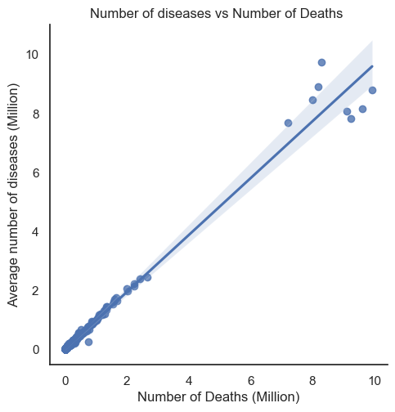
Number of deaths vs Number of diseases
As shown on the graph, there is a positive correlation between number of deaths and number of diseases.
This correlation is statistically significant, as the statistic value is close to 1.
Statistic=0.9843818251313584

Slide 29
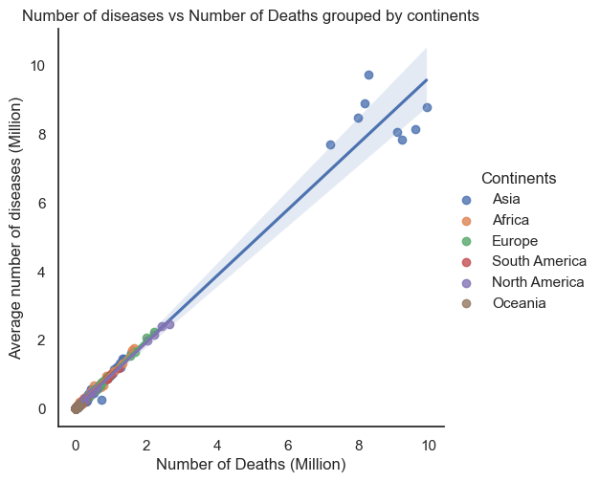
Number of deaths vs Number of diseases: Continents
The correlation number of deaths has with number of diseases, is still seen when the values are divided by continents.

Slide 30
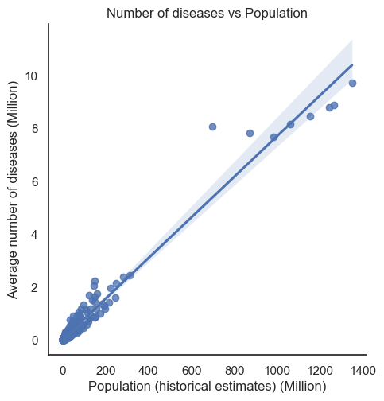
Can the relationship Number of death has with Number of diseases explain population results?
Analysis of the relationship between population and number of diseases, show a strong positive correlation. This relation can spawn reasons as to why an increase in population result in more deaths.
Reason:
Population increase, could result in communicable diseases being able to spread easier.

Slide 31
Conclusion
Number of deaths and increase.
Death rate per 100,000 has decreased
Why has number of deaths increase?
Increase in population leads to increase in diseases due to ease of spread of contaminating diseases. Resulting in an increase in number of deaths.
GDP per capita impact on number of death varies. This could be due to the distribution of wealth.
Public health expenditure impact on number of death varies depending on continents. The reason for this varies and could be due to country based factors.e.g. How public health is accessed.

Slide 33
Further Analysis
Which diseases should health services and the public be aware of?

Slide 34
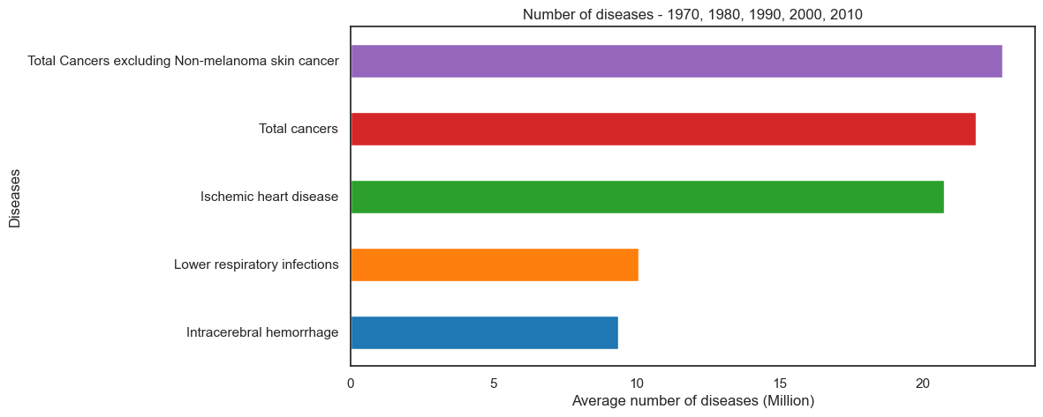
Deadliest Diseases
Cancer is the most deadliest disease.
Reasons:
Lack of cure for metastatic cancers
Lack of consistent screenings.
Bad habits e.g. smoking/ drinking
A majority of the diseases shown on the graph can be prevented with better lifestyle, easier access to public health services/medications and increase in scientific research/drug development.
Notes:
Better lifestyles examples: decrease in food consumption, less alcohol/smoking.
Public health services/medication: drug rehabilitation easier to access, medications like insulin and antiretrovirals easier to obtain regardless of country.
Scientific research/drug development: better understanding of the disease mechanism, development of new antibiotics to counter rise in antibiotic resistance.

Slide 35
Has Cancer been the most deadliest disease from 1980 - 2010 ?

Slide 36
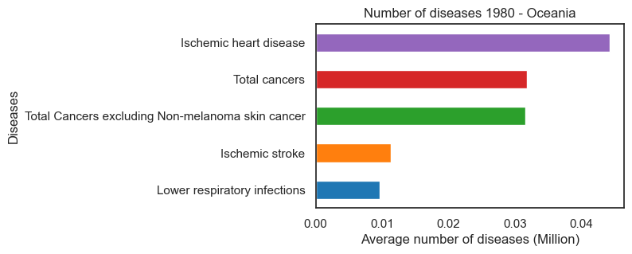
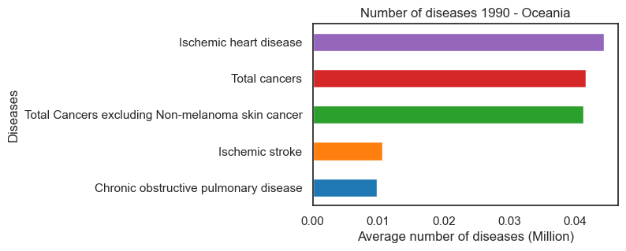
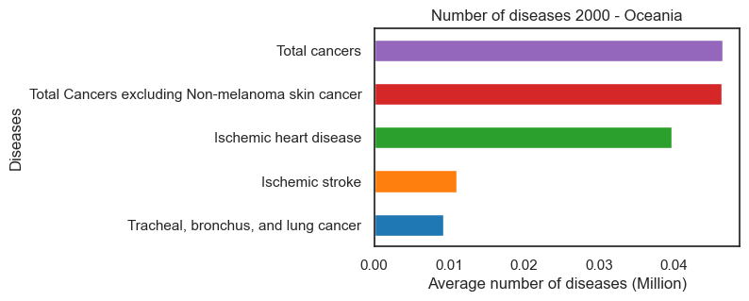
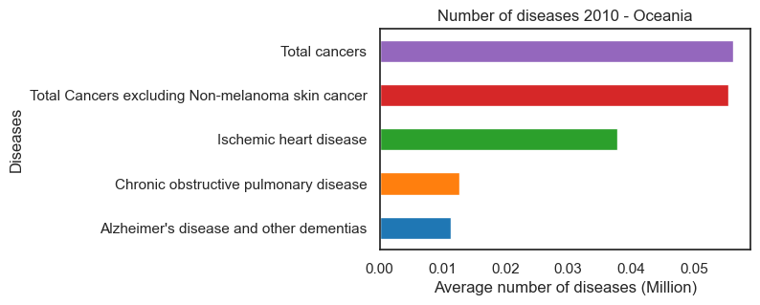
Oceania

Slide 37

Oceania insights
Cancer remains the most deadliest disease in Oceania from 1980 - 2010.
Ischemic heart diseases seem to have the same prevalence as cancer in Oceania. Remaining in the top 5 most deadliest diseases from 1980 - 2010.
Ischemic stroke and alzheimer are the two diseases present in oceania that are not seen Worldwide,
Like the other top 5 diseases seen worldwide, ischemic stroke and Alzheimer are caused by genetic, environmental and lifestyle choices. Investment in public healthcare and public awareness, can help prevent these diseases.

Slide 38
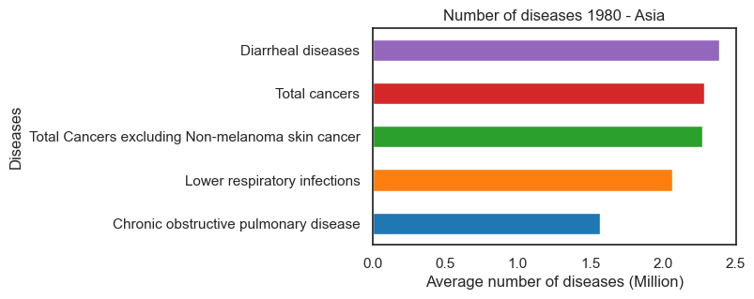
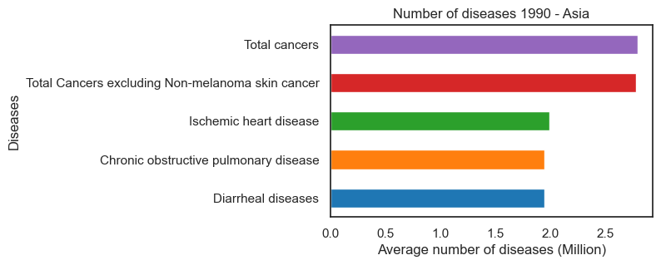
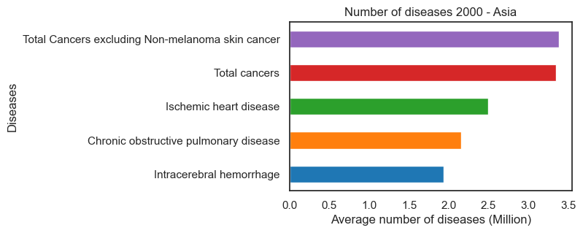
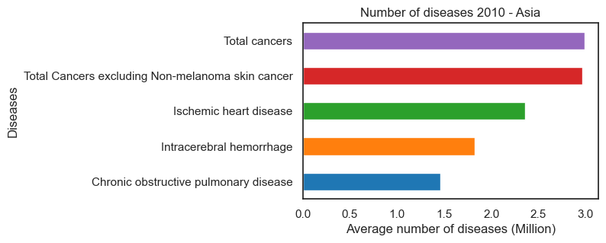
Asia

Slide 39
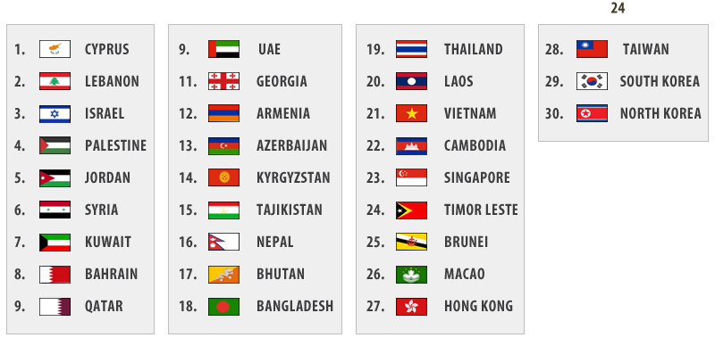
Asia Insights
Diarrheal disease beats cancer as the most deadliest disease in 1980, in Asia. Potential reason for this could be due to the the foods preparation.
Intracerebral Hemorrhage, is an unexpected diseases present in Asia from 2000 - 2010. A reason for this could be the due to genetic factors¹, though further research is needed to determine this.
Notes:
https://www.ncbi.nlm.nih.gov/pmc/articles/PMC4798495/

Slide 40
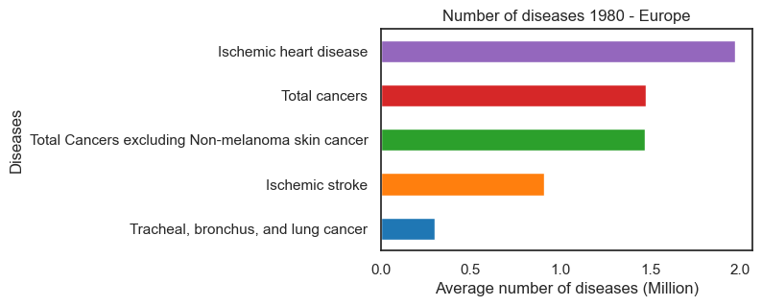
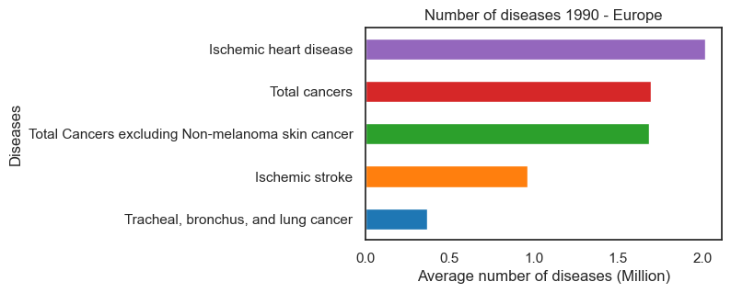
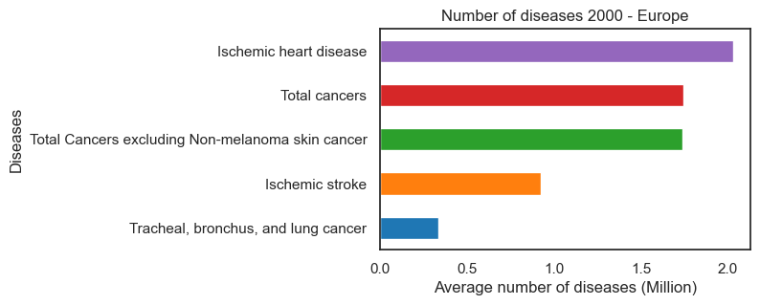
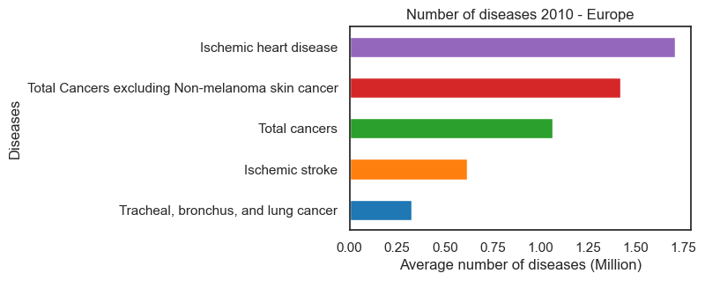
Europe

Slide 41

Europe Insights
Ischemic heart disease is the deadliest disease in Europe from 1980 - 2010. Whereas, cancer’s ranking fluctuates, but still remains in the top 5 during these years.
Ischemic heart diseases prevalence in europe could be due to lifestyle choices, caused by wealth disparity.
There have been no changes in the diseases that appear in Europe top 5 deadliest diseases. The only changes that occur is their ranking.

Slide 42
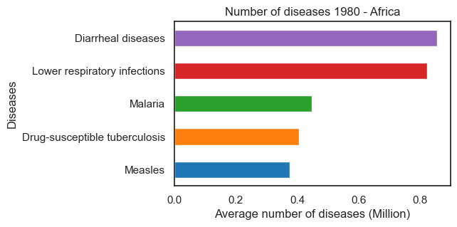
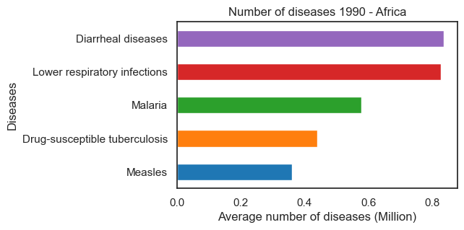
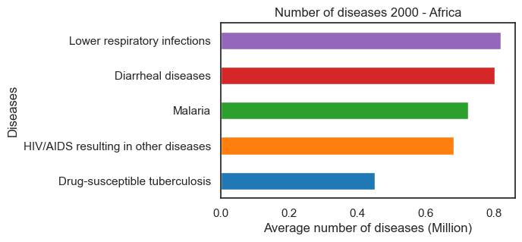
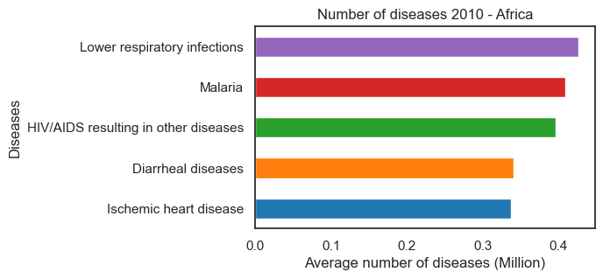
Africa

Slide 43

Africa Insights
Cancer is not present in Africa Top 5 deadliest diseases from 1980 - 2010. Diarrheal disease and lower respiratory infections are ranked first instead.
Diarrheal diseases prevalence in Africa might be due to contaminated drinking water and bad sanitation.
The rise of ischemic heart diseases in Africa probably corresponds with the introduction junk food and unhealthy lifestyle habits, to african cultures.
HIV present in Africa is probably due to African countries not being able to afford preventative medicine against the disease.

Slide 44
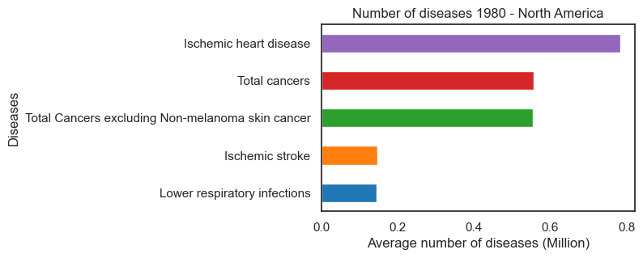
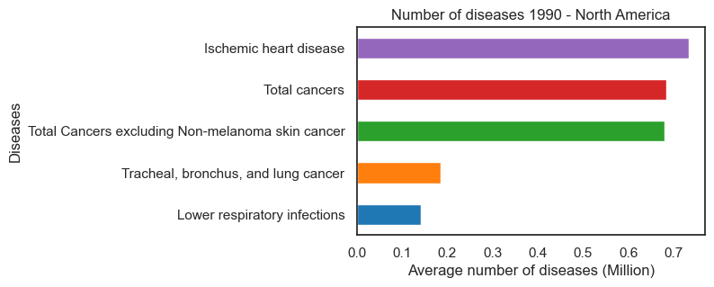
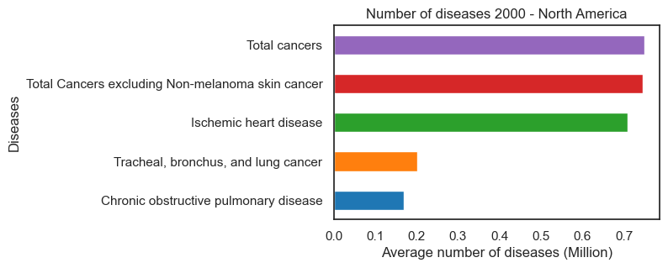

North America

Slide 45

North America Insights
Cancer and ischemic heart diseases are the most deadliest diseases in North America in 1980 - 2010. Both taking first place during these years.
Cancer commonness in North America could be because of the utilisation of cancer causing chemicals in foods, in some North American countries.

Slide 46




South America

Slide 47

South America Insights
The diseases present in South America deadliest disease in 1980 - 2010 are the same as the ones present in the Worldwide Top 5. The only difference being diarrheal diseases and intracerebral haemorrhage.
The presence of lower respiratory infections in South America could be due to country based reasons such as the cost of healthcare services and drugs.

Slide 48
Recommendations
Increase public awareness of facilities that can help prevent these diseases.
Increase public funding of facilities that prevent these diseases.
Reduction in the patent length, resul in the reduction of drug cost.
Reduce the amount needed to purchase a medicine/drugs.
Promote healthy lifestyles and better sanitation practices.
Increase in scientific research and development of new drugs. E.g. antibiotics.

Slide 49
Definitions
Correlation A relationship between two events based on pattern of change.
Causation: A change in one variable leads to a change in another variable.
Gross Domestic Product (GDP): A measure of the size and health of a country's economic health over a period of time.
Health expenditure per capita/Public health expenditure per capita: Government expenditure on health as a percentage of total government expenditure.

